Slide 1

Class 11 - Pandas
[w200] MIDS Python Course

Slide 2
Agenda
Project 2 – Introduction Project Team Coordination (10 minutes) Data Exploration and Analysis Pandas Further Team Discussions (as time allows)
Remember the guides for Numpy and Pandas in our
resources area!

Slide 3
0. Homework Unit 9 - Debrief
What were the main challenges?
What did you learn?

Slide 4
1. Project 2
1-2 page proposal: 10% 8+ page paper: 70% Final class presentation: 20%
Confidential peer review (optional)
Instructions are posted on GitHub

Slide 5
2. Activity
Talk with your team about your project [10 min]
Create your team repository!
What do you hope to get out of the project?
When would you like to meet next?
Discussion

Slide 6
2. Activity
With the time left in the course, it is critical you start your project this week
Pick a time to meet next
Exchange contact information
Establish a communication plan. Email, text, both?
Give everyone “something to do” before you meet again.

Slide 7
3. Data Exploration & Analysis Basics
http://www.byteorigin.com/services/cloud-application-development/big-data-analytics/

Slide 8
3. Data Exploration & Analysis Basics
Data Exploration
Used to ensure data integrity (what is data integrity?)
Develop questions based on the variables you have
Try to break things (better now than in production!)
Data Analysis
Seeks to answer a research question or hypothesis
May involve complex math, modeling, statistics
More likely to combine multiple dataset
Collapse and group data in various ways
Some functions are useful for both exploration and analysis!

Slide 9

3. Data Exploration & Analysis Basics
Real World Data Are Messy.
No, really. They’re very messy.
If anything can be wrong in your data, it probably is.
Your Mindset: … GOAL!

Slide 10
3. Data Exploration & Analysis Basics
Simple commands - but think deeply!
value_counts() [domain & range of the data]
describe()
max(), min(), isnull() [also check for 0, NaN, empty]
basic plots may help explore the data
histogram, scatter plot, bar chart

Slide 11
3. Data Exploration & Analysis Basics
By the way, for a good intro/review of research, see this book …
Dataset documentation
Research (library, print, data, internet)
Cross-validation and your data
E.g., if the variable “hospital_los” means “length of stay”, we should be able to compare it to variables “admit_date” and “discharge_date”
Cross-validation outside of your data
E.g., We expect power to cost the most on the hottest days of the year (demand is highest). Let’s find the maximum power cost in our dataset, and compare it to the daily temperature to ensure it makes sense.
How much data validation is “enough” ?

Slide 12
3. Data Exploration & Analysis Basics
How do I think about pseudo-coding for data analysis?
Remember, good pseudo-coding (aka Structured English) should identify & detail the functionality of your work (modules), the relationships of functionalities (not unlike how objects call each others), and most of all represents a logical process suited for both humans to follow and with sufficient details that computers can execute.
First step towards good code and better documentation.

Slide 13
3. Data Exploration & Analysis Basics
Think about an analysis as a series of dataset transformations
We might …
filter out rows based on conditions
create new columns
aggregate or collapse by groups
join two (or more) datasets together

Slide 14
4. Pandas
We’ll review some functional groups of commands that help manage and analyze data.
Resources: Pandas & NumPy help sheets in the Upstream Resources folder
Optional: see https://www.tutorialspoint.com/python_pandas/python_pandas_visualization.htm
https://pandas.pydata.org/pandas-docs/stable/10min.html

Slide 15
 |  | Description | example
Series | 1 | 1D labeled homogeneous array, sizeimmutable. | #import the pandas import pandas as pd import numpy as np data = np.array(['a','b','c','d']) s = pd.Series(data) print s
Data Frames | 2 | General 2D labeled, size-mutable tabular structure with potentially heterogeneously typed columns. | import pandas as pd data = [1,2,3,4,5] df = pd.DataFrame(data) print df
Panel | 3 | General 3D labeled, size-mutable array. | # creating an empty panel import pandas as pd import numpy as np data = np.random.rand(2,4,5) p = pd.Panel(data) print p

Slide 16
4 Pandas
Using your dataset, answer these questions:
What is the maximum donation in the data?
What is the most common occupation of people who donate this amount?
In what zip code do the most people in part (2) live?

Slide 17
4 Pandas
data = pd.Series([1,2,4,6,0,85,45,7,53,321,4,32,2355,6]) | # Let’s experiment with this series
data[data < 10] | # select values < 10
data[(data < 10) & (data > 5)] | # how ‘bout a range with keywords
data[data < 10][data > 5] | # same result but “chained” >>> data[(data < 10) & (data > 5)] 3 6 7 7 dtype: int64 >>> data[data < 10][data > 5] 3 6 7 7 dtype: int64
# using booleans as counter: (data > 5).sum() | # True = 1; False = 0
Notes:
data[data < 10 and data > 5] fails

Slide 18
4. Pandas
Slicing & Manipulating
d5 = data.head().copy() | # make a copy … for safety!
d6 = data.head(70).copy() | # specify the size of the head (ceiling, e.g., up to 70)
data[0:10:2] | $ standard slicing - [start:end (exclusive):step]
data[0] = 10000 | # value replacement
d5_6 = pd.concat([d5, d6])

Slide 19
4. Pandas
any and all tests for series
data[data < 10].any() | # true
data[data < 10].all() | # false
(data > 10000).any() | # Alternatives … false
(data > 0).all() | # false

Slide 20
4. Pandas
len(data)
data.mean() data.mode() data.median() data.count() data.std() data.unique() | # can get individual “measures of # central tendency … or use # describe() for the whole thing! >>> data.describe() count 16.000000 mean 640.312500 std 2496.070718 min 0.000000 25% 2.000000 50% 4.000000 75% 16.500000 max 10000.000000 dtype: float64
data.value_counts() | # super useful … experiment
data.shape | # note that this is an attribute, # not a method.

Slide 21
4. Pandas
data[10] | # by single index names
data[ [10,20] ] | # by multiple index names
 | # if the index is not numeric, pandas interprets numbers as row number
d5.iloc[ [0,3] ] | # lookup by index location “dict style[]”
data.index = range(100, len(data) + 100) | # set new index names
data.loc[ [100, 103] ] | # we can use .loc to call by index names
data.iget( [0,3] ), data.ix( [0,3] ) | # Depreciated - don’t use

Slide 22
4. Pandas
data.index = New_Index | # overwrite the existing index
new_data = data.reindex([0,2,15,21]) | # slide out rows and use their indices; missing values get “NaN”
data.reindex([0,2,15,21], fill_value=0) | # specify the missing values

Slide 23
4. Pandas
combo.reindex([0,2,15,21], fill_value=0) | # set fill value
new_combo.fillna(0) | # fill those NaNs!
Forward and backward fill - guess at missing values - common in practice
new_combo.ffill() | # take forward fills …
new_combo.bfill() | # take backward fills
new_combination.interpolate() | # fills missing values with linear interpolation *Note! There are several important techniques for missing values.

Slide 24
4. Pandas
s1 = pd.Series([‘1’, ‘3’])
s1 = s1.astype(int) | # what does this do to s1?
s1.map(lambda x: x**2) | # pass a series to a lambda function
s1.map({‘1’:2, ‘2’:3, ‘3’: 12}) | # basic mapping with a dictionary

Slide 25
4. Pandas
pd.DataFrame([upcase, lcase]) | # make a DataFrame from a series
pd.DataFrame({‘lowercase’: class, ‘uppercase’:upcase}) | # can pass column names
letters.columns = [‘LowerCase’, ‘UpperCase’] | # explicitly set the columns
letters.index = lcase | # change the indices
letters.sort_values(‘Number’), letters.sort_index() | # sort by column or by index
letters[ [‘LowerCase’, ‘UpperCase’] ] | # slide columns by name

Slide 26
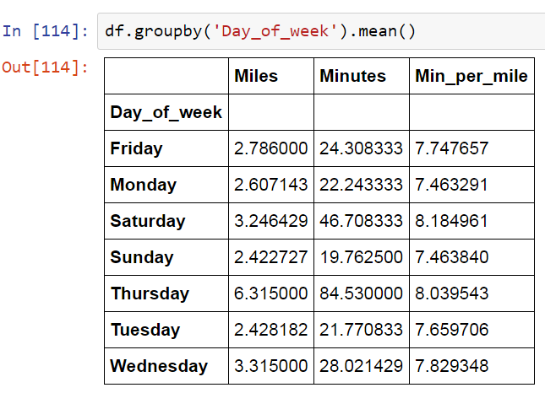
4. Pandas
Viewing your data by a category can yield critical insights

Slide 27



Good luck with your projects!
Your presentations focus on your
communication of your project, not the tech notes.
がんばろう！
¡Buena suerte!
حظا سعيدا!
सौभाग्य!
Удачи!
祝好运！
Viel Glück!
اچھی قسمت!
ਖੁਸ਼ਕਿਸਮਤੀ!
સારા નસીબ!

